Slide 1
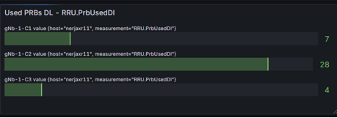
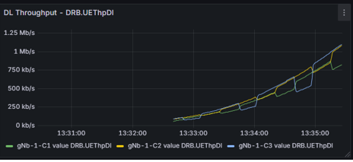
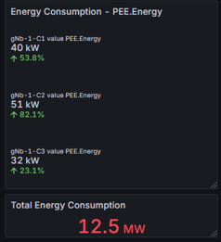
Demonstration Components
RAN KPIs
Grafana Dashboards
Full Keysight RAN simulator for the scenario described
FlexRIC, O-RAN compliant nearRT-RIC
KPM Style 1 xApp to collect cell level KPIs
The xApp is configurable via JSON file, allowing for tailoring of the KPIs of interest as well as from which E2 and cell to collect them from.
InfluxDB for time series database used to collect KPIs
Telegraf, used as xApp proxy to push KPIs into InfluxDB
Grafana for simple KPI dashboards showing RAN/Cell level KPIs and tracked UE KPIs
“poll” KPIs
InfluxDB
“all” KPIs
Telegraf
RAN KPIs
FlexRIC
Scenario Simulator
RICTest
Style 1
KPM xApp
E2

Slide 2

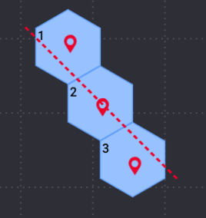
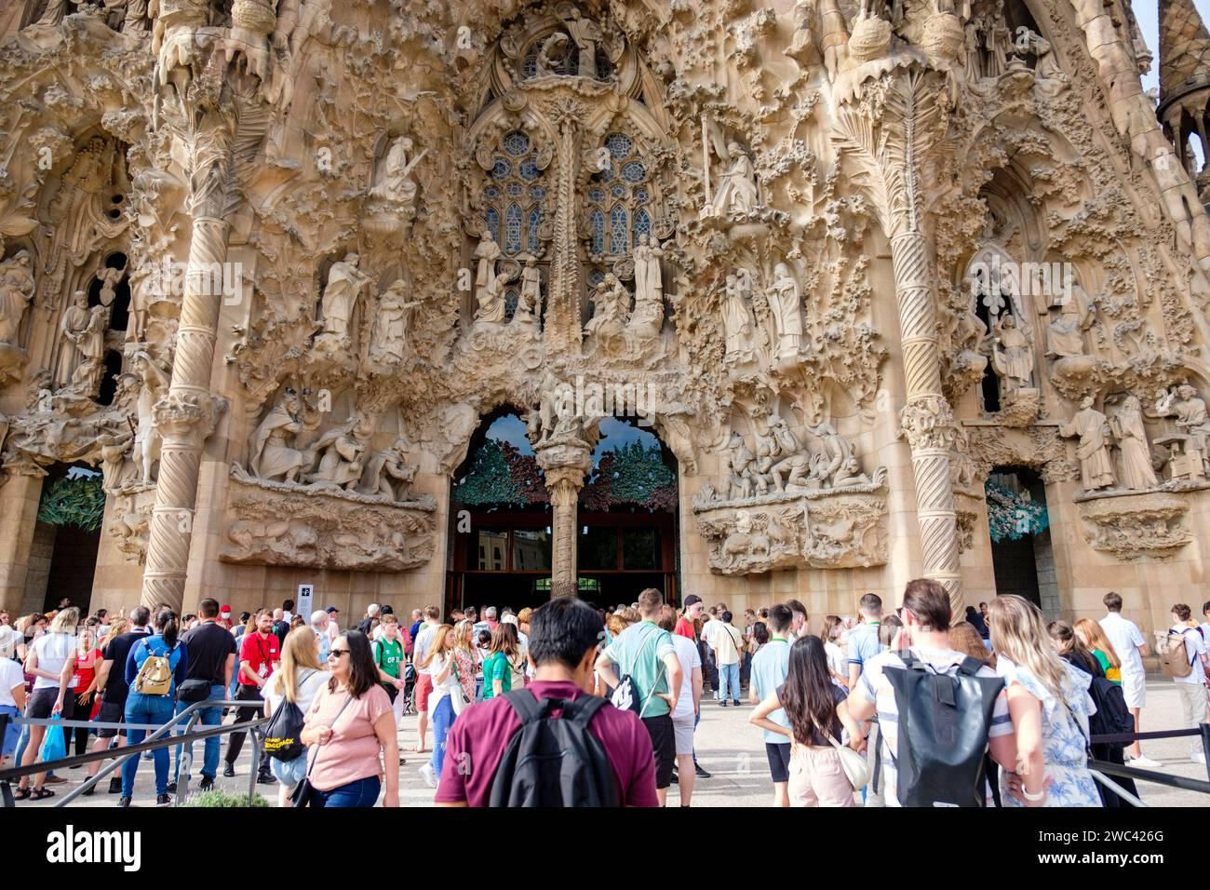
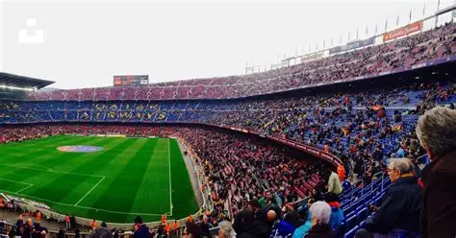

Scenario Description
3 Slices are created to support various traffic types:
Slice 1: GBR Traffic, 5QI = 1, UL= 380 Kbps, DL = 380 Mbps
Slice 2: GBR Traffic, 5QI = 4, UL = 300 Kbps, DL = 400 Mbps
Slice 3: Non-GBR Traffic, 5QI = 5, UL =105 Mbps, DL = 105 Mbps
3 Cells assigned to a single gNB each are uses to simulate handovers. All three slices are supported by all cells.
UE-1 represents an emergency vehicle, like a fire truck or ambulance that requires GBR methods to support incoming video streaming. This is assigned to a straight-line mobility path travelling at 20 m/s and to Slice 1. The UE requires a 5QI = 1, UL = 64 Kbps, and DL = 10 Mbps.
UE-2 represents a civilian population of subscribes using non-GBR methods of streaming and data services. This group is assigned to a stationary mobility path camped on Cell 1 and on Slice 3. The subscribers requires a 5QI = 5, UL = 5 Mbps, and DL = 10 Mbps.
UE-3 represents a civilian population of subscribes using GBR methods of streaming and data services. This group is assigned to a stationary mobility path camped on Cell 2 and on Slice 2. The subscribers requires a 5QI = 4, UL = 20 Kbps, and DL = 15 Mbps.
The cell configuration for this simple scenario in RCTest is illustrated above. Where the straight line shows the path of the emergency vehicle as it traverses the 3 cells at a speed of 20 ms. The red tags in each cell simulate an example set of stationary users/walking users at different city locations covered by the 3 cells.
Each cell is 2 km in diameter, so to ensure UE-1 crosses all 3 cells at a speed of 20ms, you need to run the simulation for a minimum of 300 seconds.
UE-4 represents a civilian population of subscribes using non-GBR methods of streaming and data services. This group is assigned to a stationary mobility path camped on Cell 4 and on Slice 3. The subscribers requires a 5QI = 5, UL = 5 Mbps, and DL = 10 Mbps.
Notes:
Note the diameter of the cels is 2 Km each, so travelling at a speed of 20 ms, you need at least 300 seconds of time to cross all 3 cells

Slide 3
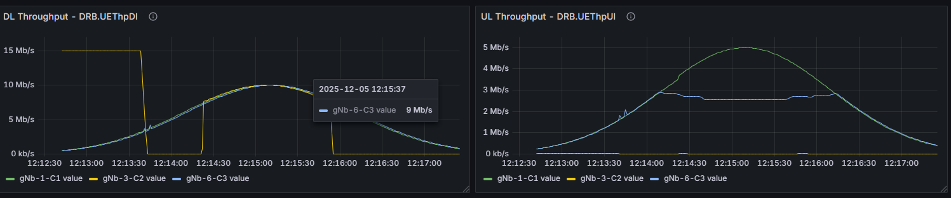
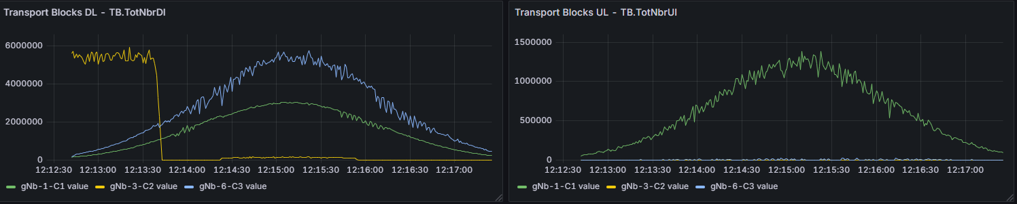
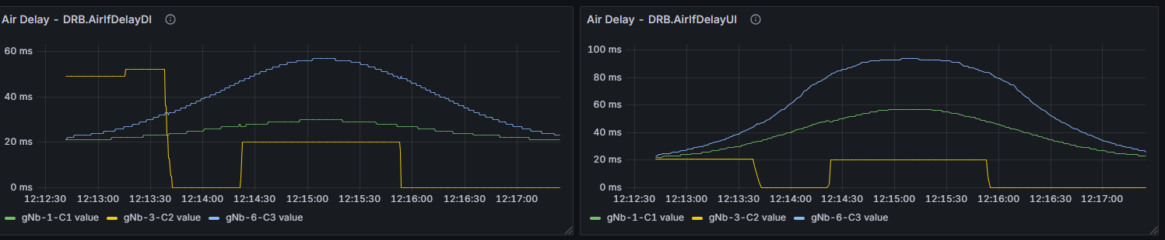
Data Sets – Cell Level KPIs

